Slide 1
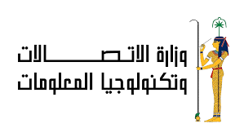



Generative AI
Project
Advanced chatbot
Presented by: Ali Shaker

Slide 2

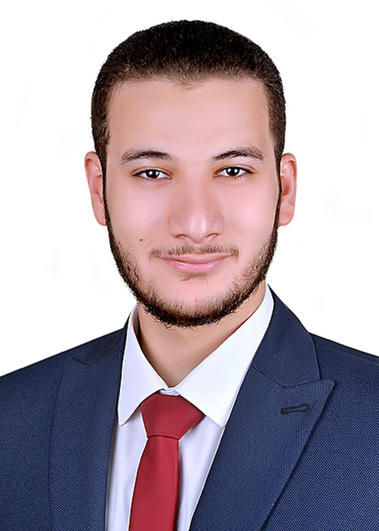
About me
Project Manager at Orchida soft
Graduated from Faculty of Computer and Information Science Ain Shams University class 2021
Preparing for a master’s degree in deepfake detection
Founder of Hurry up Academy
Ali Shaker

Slide 3

Overview
Introduction
Objective
Tools & Technologies
Data Collection and Preprocessing
Model Development & Training
Chatbot Evaluation
Deployment
Future Work
Conclusion

Slide 4
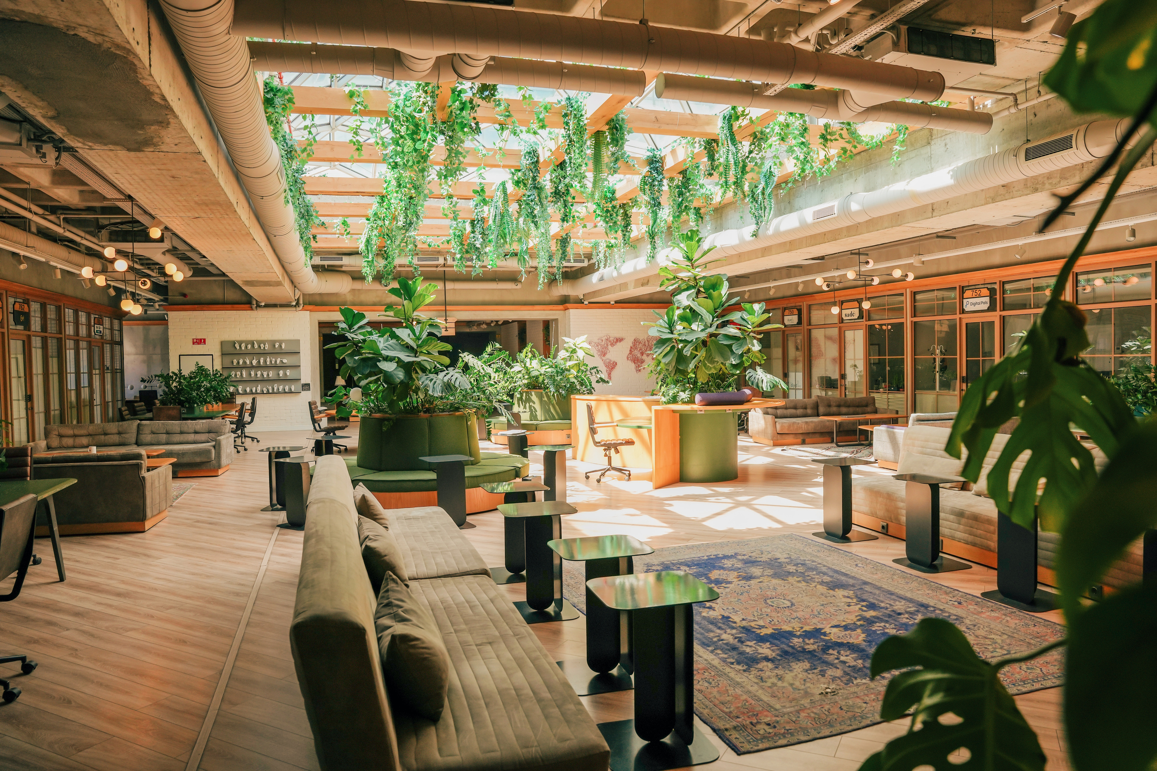

Introduction
This project focuses on developing a chatbot using a transformer-based modelfor dynamic and human-like responses.

Slide 5
Objective
To build a conversational AI chatbot using GPT-2 and evaluate its performance.

Slide 6
Tools & Technologies
Python
Hugging Face Transformers
GPT-2
MLflow
Google Colab.

Slide 7


Dataset
Data Collection and Preprocessing
DailyDialog dataset containing conversational data
Data Cleaning
Data was cleaned by removing special characters, tokenized using NLTK, and lemmatized with SpaCy

Slide 8
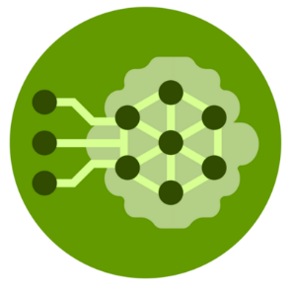
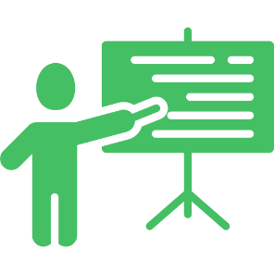

Model used
Used a GPT-2 transformer-based model for generating dynamic responses
GPT-2 is known for its ability to understand context and generate human-like text
Model Development & Training
Training Process
Fine-tuned the GPT-2 model using the cleaned DailyDialog dataset
Training Parameters:
Learning Rate: 2e-5
Number of Epochs: 3
Batch Size: 4
Maximum Token Length: 128
MLflow Tracking
Utilized MLflow for experiment tracking and model version control.
Tracked metrics such as training loss, validation accuracy, and model parameters

Slide 9



Testing Prompts
The chatbot was tested using various prompts to assess its ability to generate relevant and coherent responses.
Chatbot Evaluation
Performance Analysis
Evaluated the chatbot's responses based on fluency, context understanding, and relevance.
Some challenges included occasional generic responses to diverse queries.
Challenges
Limited time for fine-tuning impacted the depth of the model's understanding
Balancing training time with computational resources in Google Colab

Slide 10

Deployment
Deployed the chatbot using a Flask API for easy interaction and testing
The Flask server allows users to send prompts and receive responses in real-time
Hosted on Google Colab for demonstration purposes
Deployment

Slide 11

Future Work
Integrate feedback mechanisms to continuously improve chatbot responses.
Explore larger models like GPT-3 or fine-tune on more diverse datasets for better understanding of various topics
Implement a user-friendly web interface for easier access and interaction with the chatbot
Future Work

Slide 12
Conclusion
"Successfully built a GPT-2-based chatbot capable of generating dynamic and context-aware responses."
"The project demonstrated the potential of transformer models in conversational AI."
"Tracked the entire training and evaluation process using MLflow, ensuring reproducibility and version control."
"Gained valuable insights into the challenges of fine-tuning language models within limited time and resources."

Slide 13


Thank you

